Slide 1
zSpace Professional Development
Ruth Ramos
Please register
https://zspace.com

Slide 2
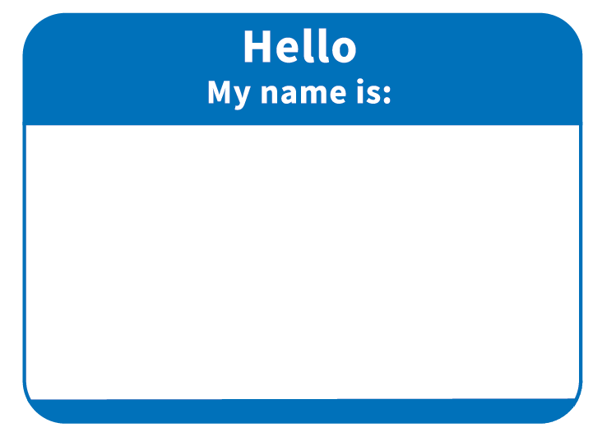
Welcome & Introductions
Ruth Ramos
Professional Development
rramos@zspace.com

Slide 3
zSpace – Goals & Objectives
Goals
Objectives
Make connections
Engage students
Improve learning
List purpose of each zSpace app
Identify key features in each app
Locate zSpace Resources
Plan 3 lessons integrating zSpace

Slide 4
zSpace Session #1 Agenda
Introduction
Learn the Application
Sign in for PD at
https://zspace.com/pd/
Discuss zSpace or VR/AR experiences
Application Focus: Human Anatomy Atlas
zSpace Workflow
zSpace Resources
Managing the zSpace AIO
https://zspace.com/edu/
zSpace pre-made lessons
Google Docs
Online Community /Online PD
zSpace power button/shut down
Maintaining the zSpace and Accessories

Slide 5
ENGAGE
REINFORCE
COLLABORATE
Introduce ideas and concepts through model exploration
Teachers present / students learn independently to reinforce concepts
Students collaborate to create content or teach others
INTEGRATE
DIFFERENTIATE
Pair zSpace with existing labs to strengthen curriculum
Adapt activities to meet student needs

Slide 6
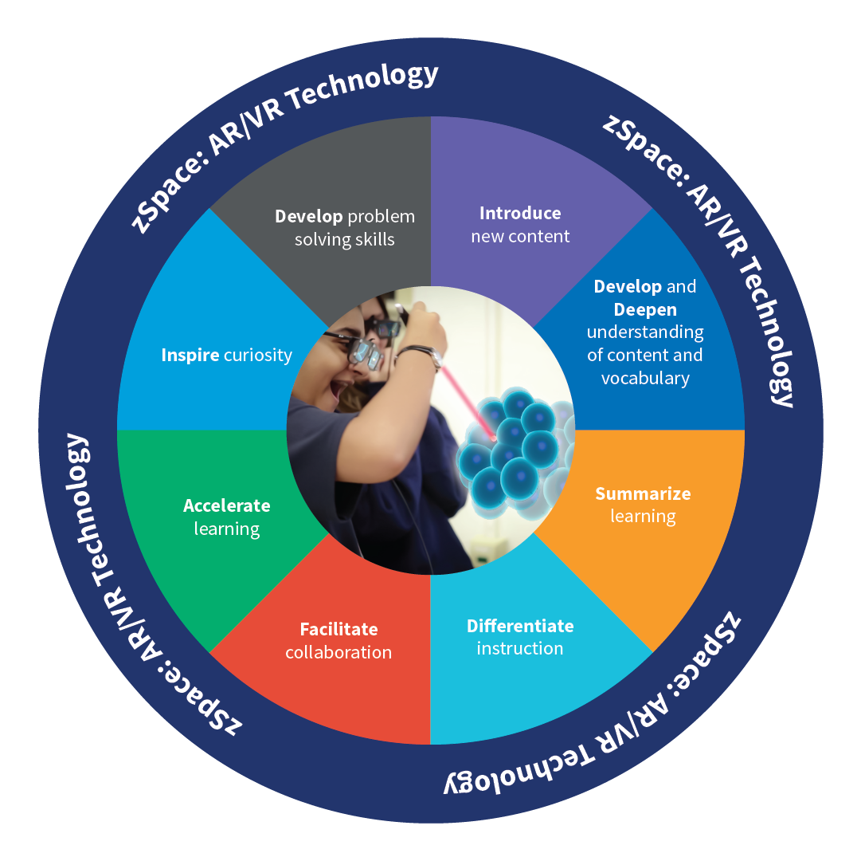
zSpace Agenda
Build zSpace skills to instruct and integrate into Allied Health
1. Build zSpace skills to instruct and integrate into Allied Health
2. Understand how different applications can be used to teach Allied Health
3. Develop a plan to integrate zSpace

Slide 7
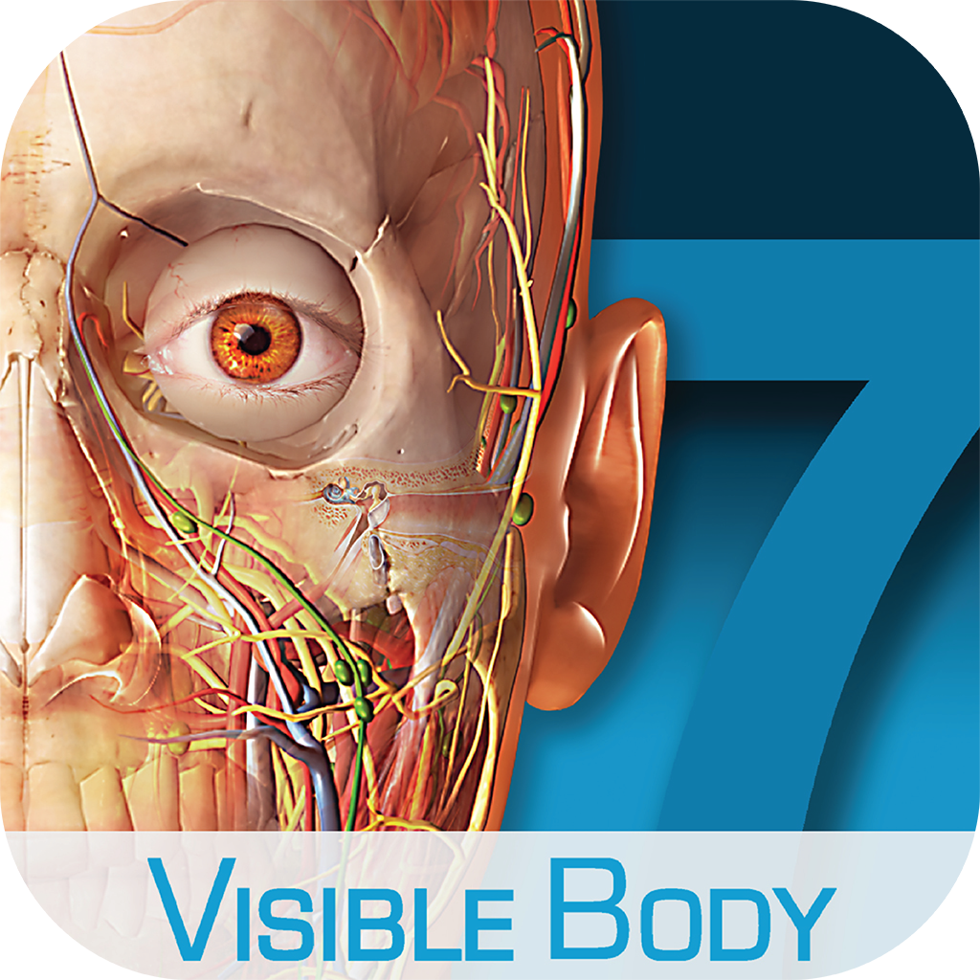
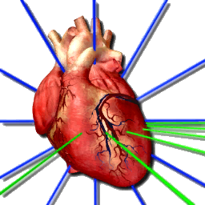
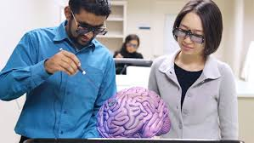
CTE
Allied Health * Health Science * Medical
Standard Industry Certifications:
CMAA (Certified Medical Admin Asst)
EKG/ECG (Electrocardiogram)
CNA (Certified Nursing Asst)
Phlebotomy
CPT (Certified Patient Tech)
RT (Respiratory Therapist)
LPN (Licensed Practical Nurse)
RN (Registered Nurse)

Slide 8
zSpace Applications
zSpace Studio
Newton’s Park
Franklin’s Lab
Experiences
VIVED Science
VIVED Chemistry
Human Anatomy Atlas
Virtual ECG
Tinkercad
Leopoly
Geogebra

Slide 9
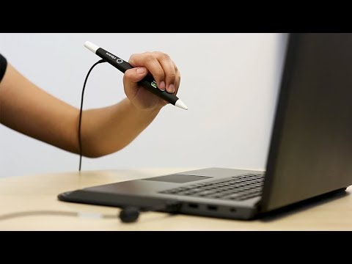
Let’s Get Started!
Notes:
Let’s explore zSpace Watch the video and then as a guest open a tutorial that is listed.

Slide 10
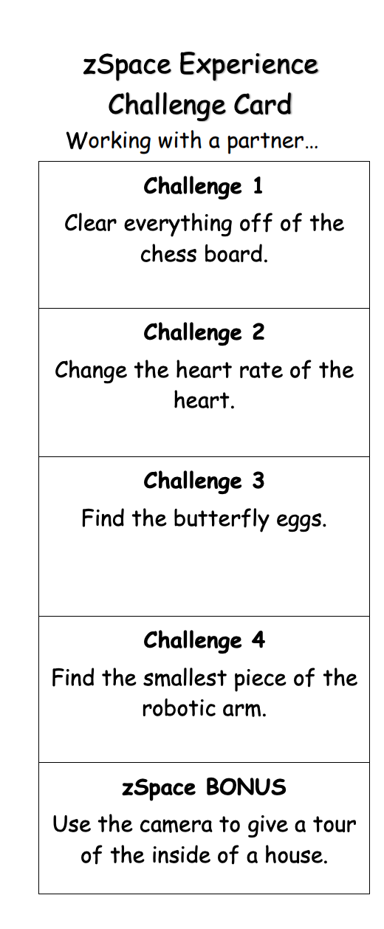
zSpace Demo
Purpose: Become familiar with the stylus and glasses
Launch zCentral from Desktop
Select Quick Launch
Enter Code AP88 (zSpace Demo)
Complete the Challenge Card!

Slide 11
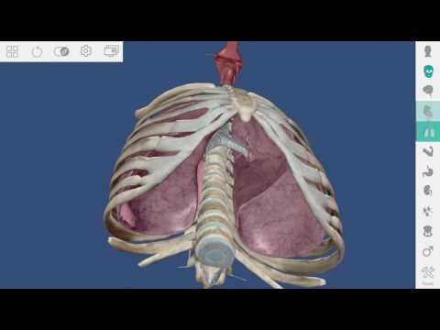
Human Anatomy Atlas
Purpose: Scaffold knowledge through model exploration
Learning/Presentation tool
Dissect, analyze, learn, assess
Explore 3D models
Science Practices:
Engage in Argument from Evidence
Constructing Explanations
Obtain, Evaluate, Communicate Information

Slide 12
Human Anatomy Atlas
Purpose: Become familiar with the features and workflow of Human Anatomy Atlas
Launch the App
Explore
Launch zCentral
Select Quick Launch
Enter Code AP26 or type Human Anatomy Atlas
Select Launch
Settings
Systems
Menu
Systems View
Media
Quizzes

Slide 13
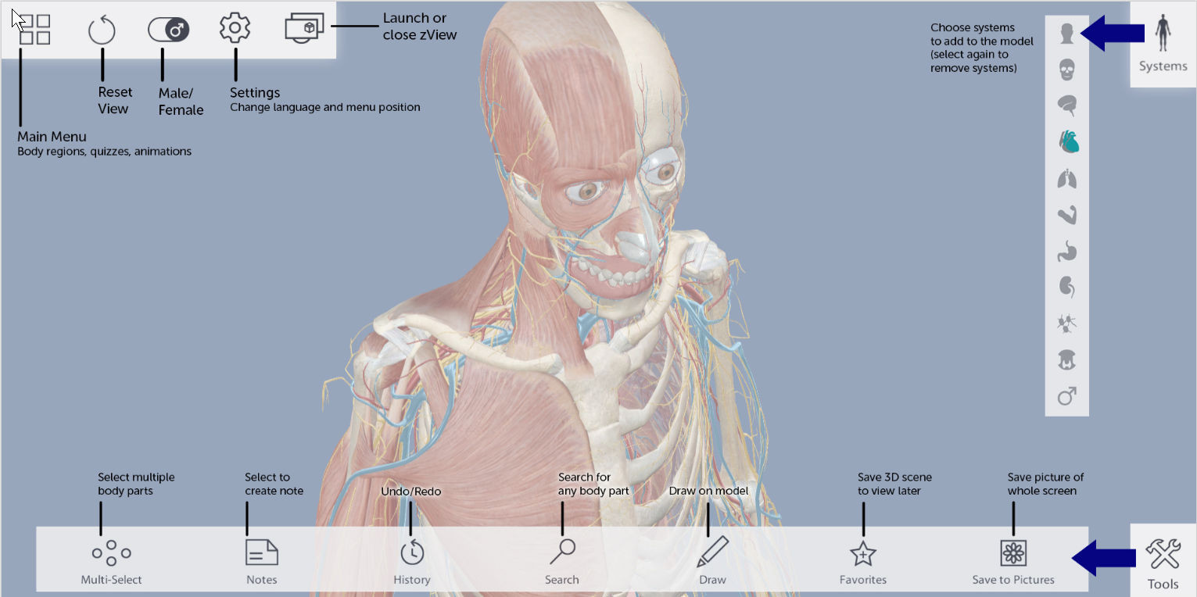
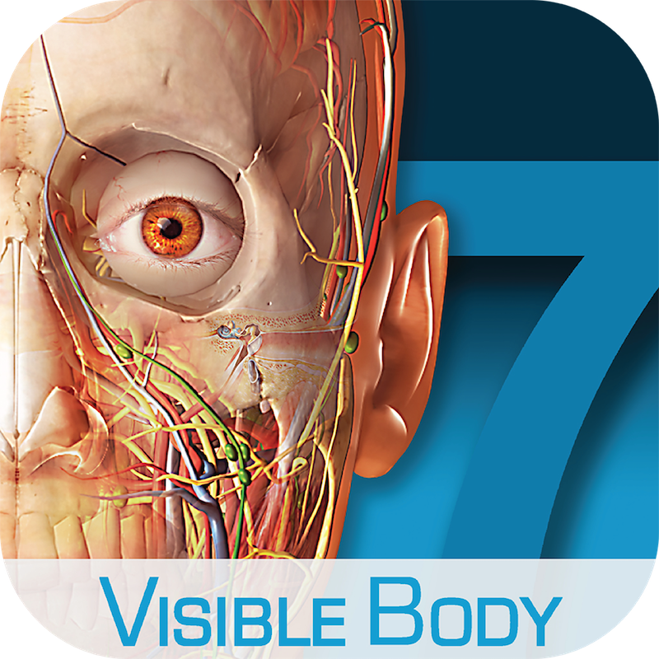
Health Sciences
Human Anatomy Atlas
Resources
Let’s Take a look at the Heart Lab Manual
Partner up and choose a Lab Manual on VB’s site
Walk Through the Activity
Discuss:
What students will have to be able to do.
Questions about how to complete tasks that you don’t understand

Slide 14
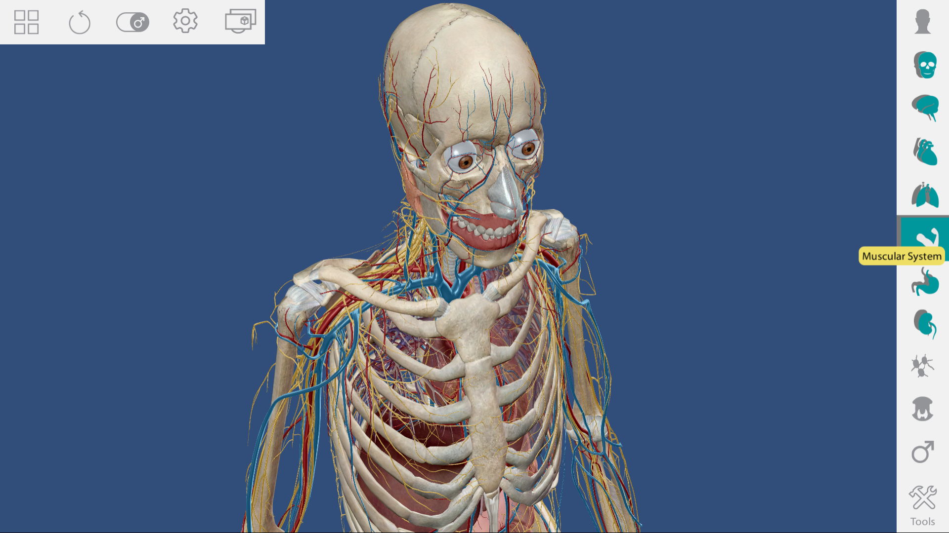
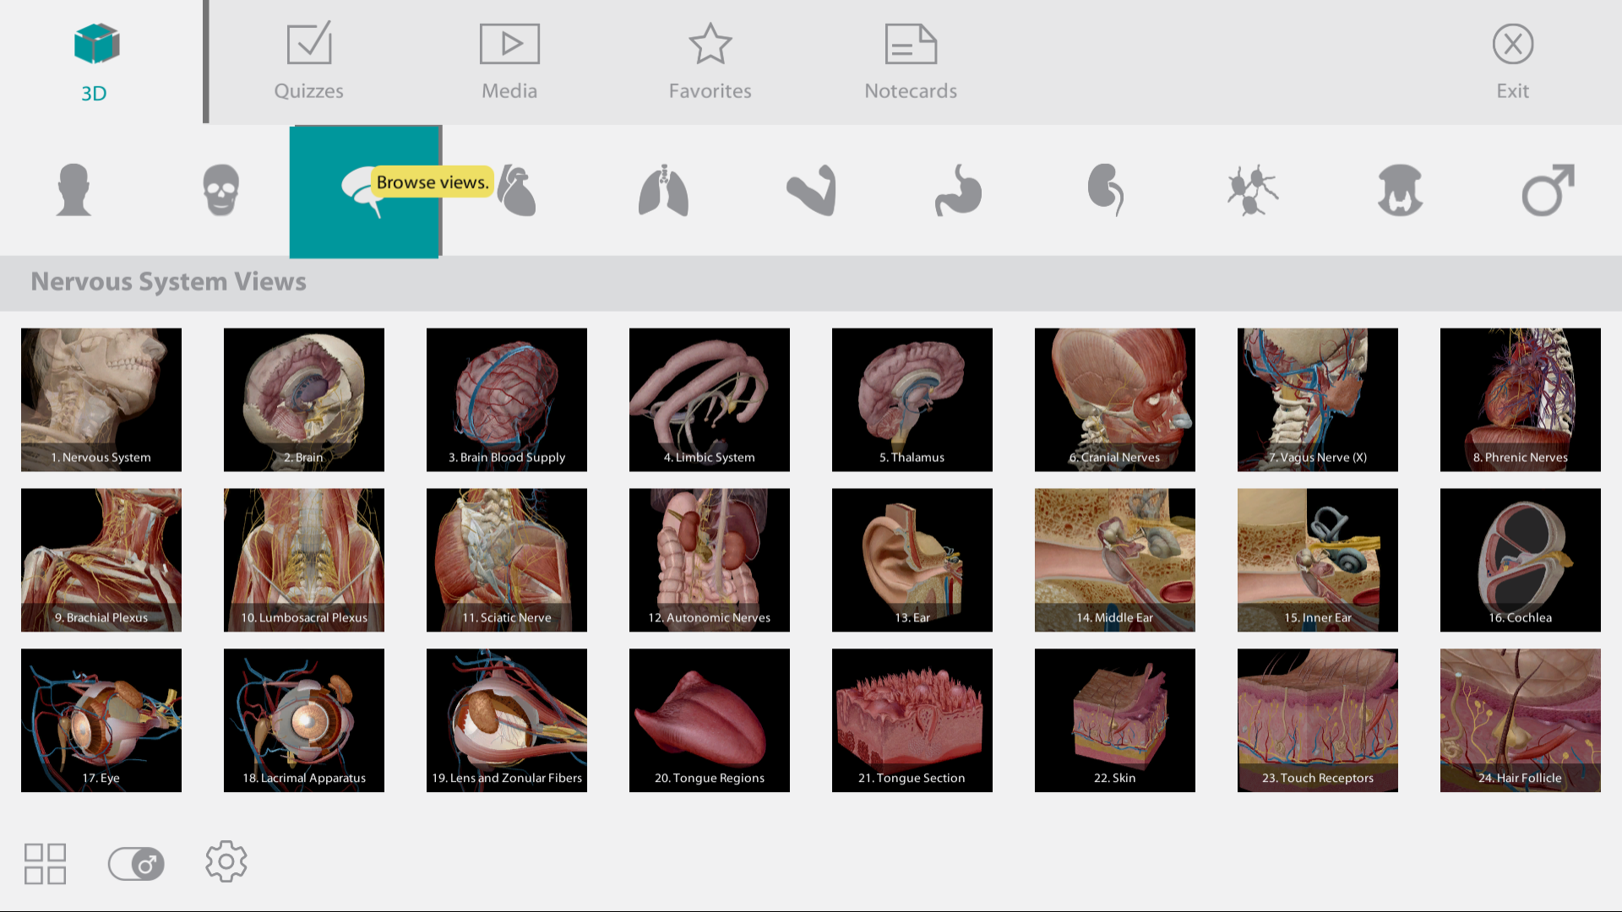
Human Anatomy Atlas
Human Anatomy Atlas

Slide 15
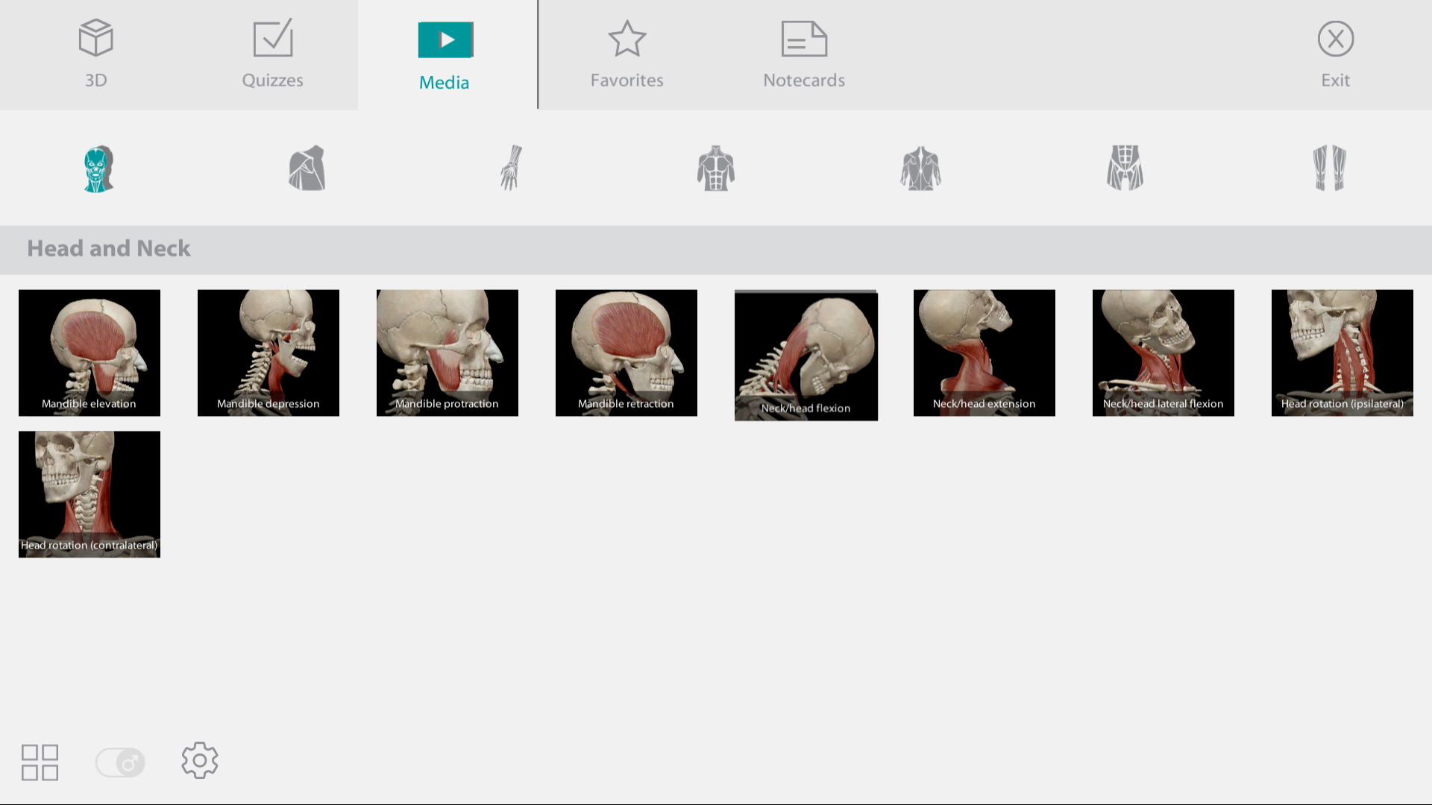
Human Anatomy Atlas
Body Mechanics for CNA, PCT, RN, and LPN
Where is your “old sports injury”?
Human Anatomy Atlas

Slide 16
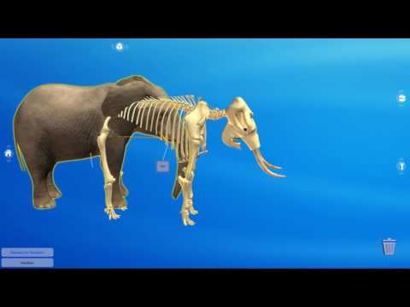
zSpace Studio
Purpose: Scaffold knowledge through model interaction and exploration
Explore with 3D models
Use tools to compare, dissect, analyze, measure, annotate
Learn through scaffolded lessons
Assess formatively through guided questions
Science Practices:
Develop and Use Models
Engage in Argument from Evidence
Constructing Explanations
Obtain, Evaluate, Communicate Information

Slide 17
zSpace Studio
Purpose: Become familiar with the features and workflow of zSpace Studio.
Go to zCentral Quick Launch
Enter Code A295 (Extended Tutorial for Educators)
Read through the prompts to complete the activity
Notice where to save (copy to clipboard or save as a PDF)

Slide 18
zSpace Studio
Purpose: Become familiar with the features and workflow of zSpace Studio.
Open a Lesson:
Launch zCentral
Enter Code A295 (Extended Tutorial for Educators)
Read through the prompts to complete the activity
Answer questions when prompted
Save and Submit (5 options):
In Studio, Save lesson as a PDF; open Google Chrome, login to teacher site, upload and submit
In Studio, Copy lesson to Clipboard, open Google Chrome on the zSpace, open google doc or microsoft word, paste, and submit
Open worksheet in Google Docs or Microsoft Word, document answers for the activity on a separate device, submit or auto save
Print the worksheet; write down answers and submit
After completing a lesson, answer 1-3 questions on a teacher created Exit Slip, then submit
On zSpace
On zSpace
Separate Device and Online
Print copy
Print or Online

Slide 19
zSpace Studio Resources
zSpace Studio All Resources
zSpace Studio Reference Guide
zSpace Studio Model Catalog
Search for zSpace Studio Activities

Slide 20
zSpace for Education
zspace.com/edu
Purpose: Find resources to facilitate learning about zSpace applications, connect to our online community, implement different learning strategies and plan for lessons. (Click on the links below.)
Getting Started
Online Community
Browse Learning Content
Search Content by Keyword
zCentral
Technical Resources
More zSpace Support
Online Professional Development

Slide 21
Maintenance & Support
Nightly Updates to the Applications - sleep mode and plugged in
zSpace Hardware Maintenance
Contacting Support
support@zspace.com for Customer support
profdev@zspace.com for PD support
1-877-977-2231
Use the “Chat” button at www.zspace.com/edu

Slide 22
Leopoly
Tinkercad
Purpose: Design/Create 3D Models
Import into zSpace Studio or print
Location: zCentral code AP29
Purpose: Design/Create 3D Models
Import into zSpace Studio or print
Location: tinkercad.com

Slide 23
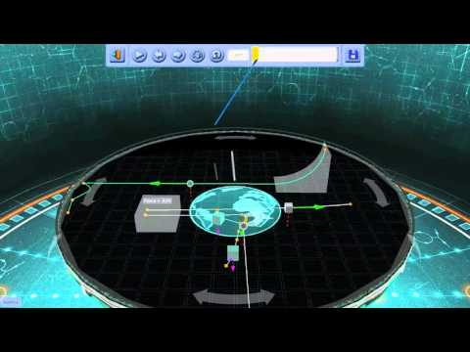
Newton's Park
Purpose: Plan and carry out investigations to learn about Newton’s Laws
Simulations
Create and test experiments in a vacuum
NGSS Practices:
Plan and Carry out Investigations
Analyze and Interpret Data
Ask Questions
Use Mathematics and Computational Thinking

Slide 24
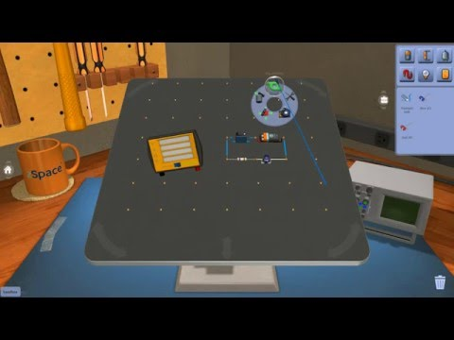
Franklin’s Lab
Purpose: Learn about open and closed circuits through problem solving and troubleshooting
Simulations
Create and test circuits
Troubleshoot and problem solve
NGSS Practices:
Plan and Carry out Investigations
Analyze and Interpret Data
Ask Questions
Obtain, Evaluate, Communicate Information

Slide 25
Newton’s Park
Franklin’s Lab
Purpose: Become familiar with the features and workflow of Newton’s Park and Franklin’s Lab.
Try This!
Extended Tutorial (A442)
Balanced and Unbalance Forces (A397)
Ball to Cup (A411)
Launched vs Dropped (A446)
Try This!
Extended Tutorial (A363)
Open and Closed (A337)
Quadcopter 1, 2, 3 (A342, A343, A344)
Resisting the Flow (A349, A346)

Slide 26
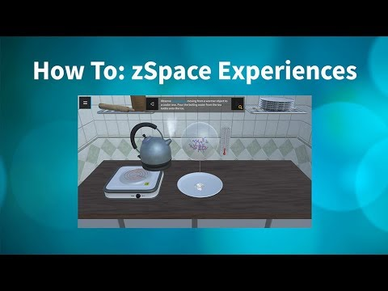
zSpace Experiences
Features in zCentral:
Search by selecting “Experiences” under Content Type
Select “Resource” to see suggested Activity Plans and Resources
Select Launch to launch Experience
Try This!
Exploring Plants (E426)
Human Response to the Flu (E436)
Fish Structure and Function (E410)
Sea and Land Breezes (E421)

Slide 27
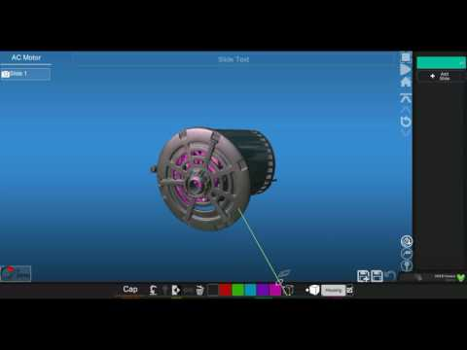
VIVED Science
Purpose: Use dissectible models to explore and scaffold learning. Create formative assessments.
Dissectible Models
Create Formative Assessment
Students create presentations
NGSS Practices:
Develop and Use Models
Engage in Argument from Evidence
Constructing Explanations
Obtain, Evaluate, Communicate Information

Slide 28
VIVED Science
Purpose: Become familiar with the features and workflow of VIVED Science.
Go to zCentral Quick Launch
Enter Code AP27
Choose “New Session” to explore models
Learn how to use the stylus to manipulate the models
“Open Sessions” to view pre-made sessions

Slide 29
VIVED Science Resources
VIVED Science All Resources
VIVED Science Content List
VIVED Science Teacher’s Guide

Slide 30
VIVED Chemistry
Purpose: Use activities and simulations to support physical science and chemistry instruction
Simulations, Tools
Activity Types
Introductory
Content
Explore
Content
Introduction to Atom Builder
Introduction to Bonding
Introduction to Interactive Periodic Table

Slide 31
VIVED Chemistry
Purpose: Become familiar with the features and workflow of VIVED Chemistry. (AP30)
Introductory Lessons
Lessons that introduce content and simulations:
Atom Builder
Bonding
Interactive Periodic Table
Radioactive Delay
Different Types of Reactions
Exploratory Lessons are Sandboxes to explore simulations:
Atom Builder - Explore
Bonding - Explore
Crystals - Explore
Gas Properties - Explore
Interactive Periodic Table - Explore
Molecular Viewer - Explore
Orbital Analyzer - Explore
pH - Explore

Slide 32
VIVED Resources
VIVED Science All Resources
VIVED Science Content List
VIVED Science Teacher’s Guide
VIVED Chemistry Science All Resources
VIVED Chemistry Teacher’s Guide

Slide 33
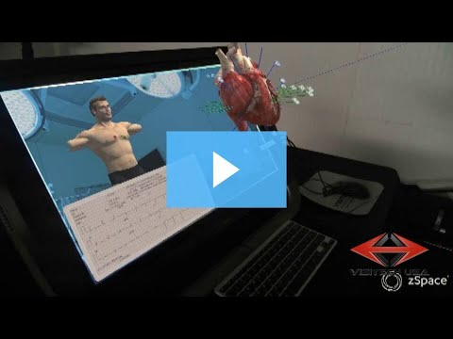
Virtual ECG
Purpose:

Slide 34
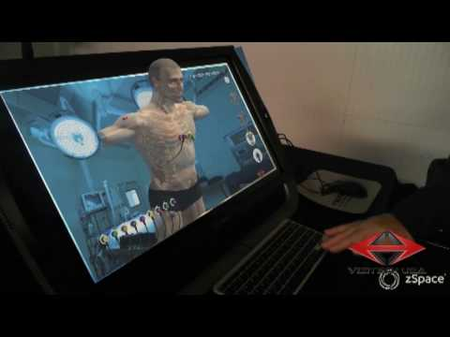
Virtual ECG
Quick Launch Code
AP33

Slide 35
More zSpace Print Resources
zSpace Studio Reference
Description of Applications
Franklin’s Lab Reference
Leopoly Tutorial
Newton’s Park Reference
Hardware Maintenance
Experiences Reference
Challenge Card

Slide 36
Closing/Comments
What did you like?
Next Steps
Survey:

