Slide 2
Each of our 21 sites has a Youth Action Council!
INTRODUCING….

Slide 3
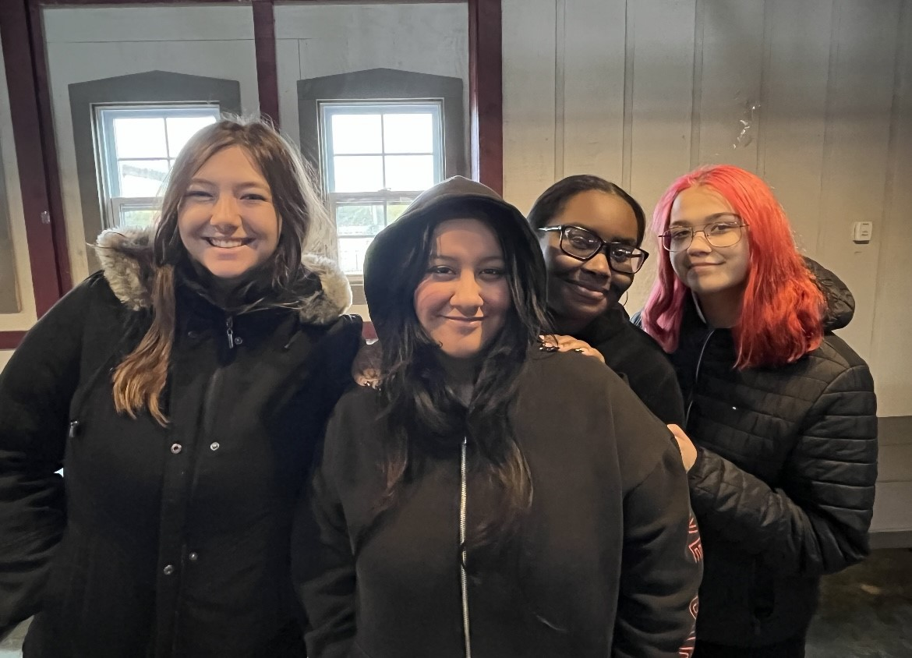
Clintondale High School
President: Anneka Palacio
Vice President: Amari Stewart
Secretary: Jazzlyn Lamond
Treasurer: Serenity Webb
Social Media Chair: Le’la Joy Matthews

Slide 4
Cody High School
PRESIDENT: Dominique Hubbard
VICE PRESIDENT: Walter Shears
SECRETARY: JaMirh Smith
TREASURER: Alantae Terry
SOCIAL MEDIA CHAIR: Kamiya Page
Member at Large: Chance Tolbert

Slide 5
Denby High School
Representatives (Denby chose to have representatives from each grade, instead of one president representing all. This works best for our site.)
NINTH GRADE REPRESENTATIVE: Deshawna Hunt
TENTH GRADE REPRESENTATIVE: Chanel Martin
ELEVENTH GRADE REPRESENTATIVE: Deshaun Himes
TWELFTH GRADE REPRESENTATIVE: Terrance Robinson
SECRETARY: Mya Nichols
SOCIAL MEDIA MANAGERS: Justin Ruffin; Dar’Neisha Dozie; Rayshawn Stewart

Slide 6
East English Village
President: Kenneth Braxton
Vice President: Tito Burleigh
Treasurer: Shardney Coleman
Secretary: Destiny Jackson

Slide 7
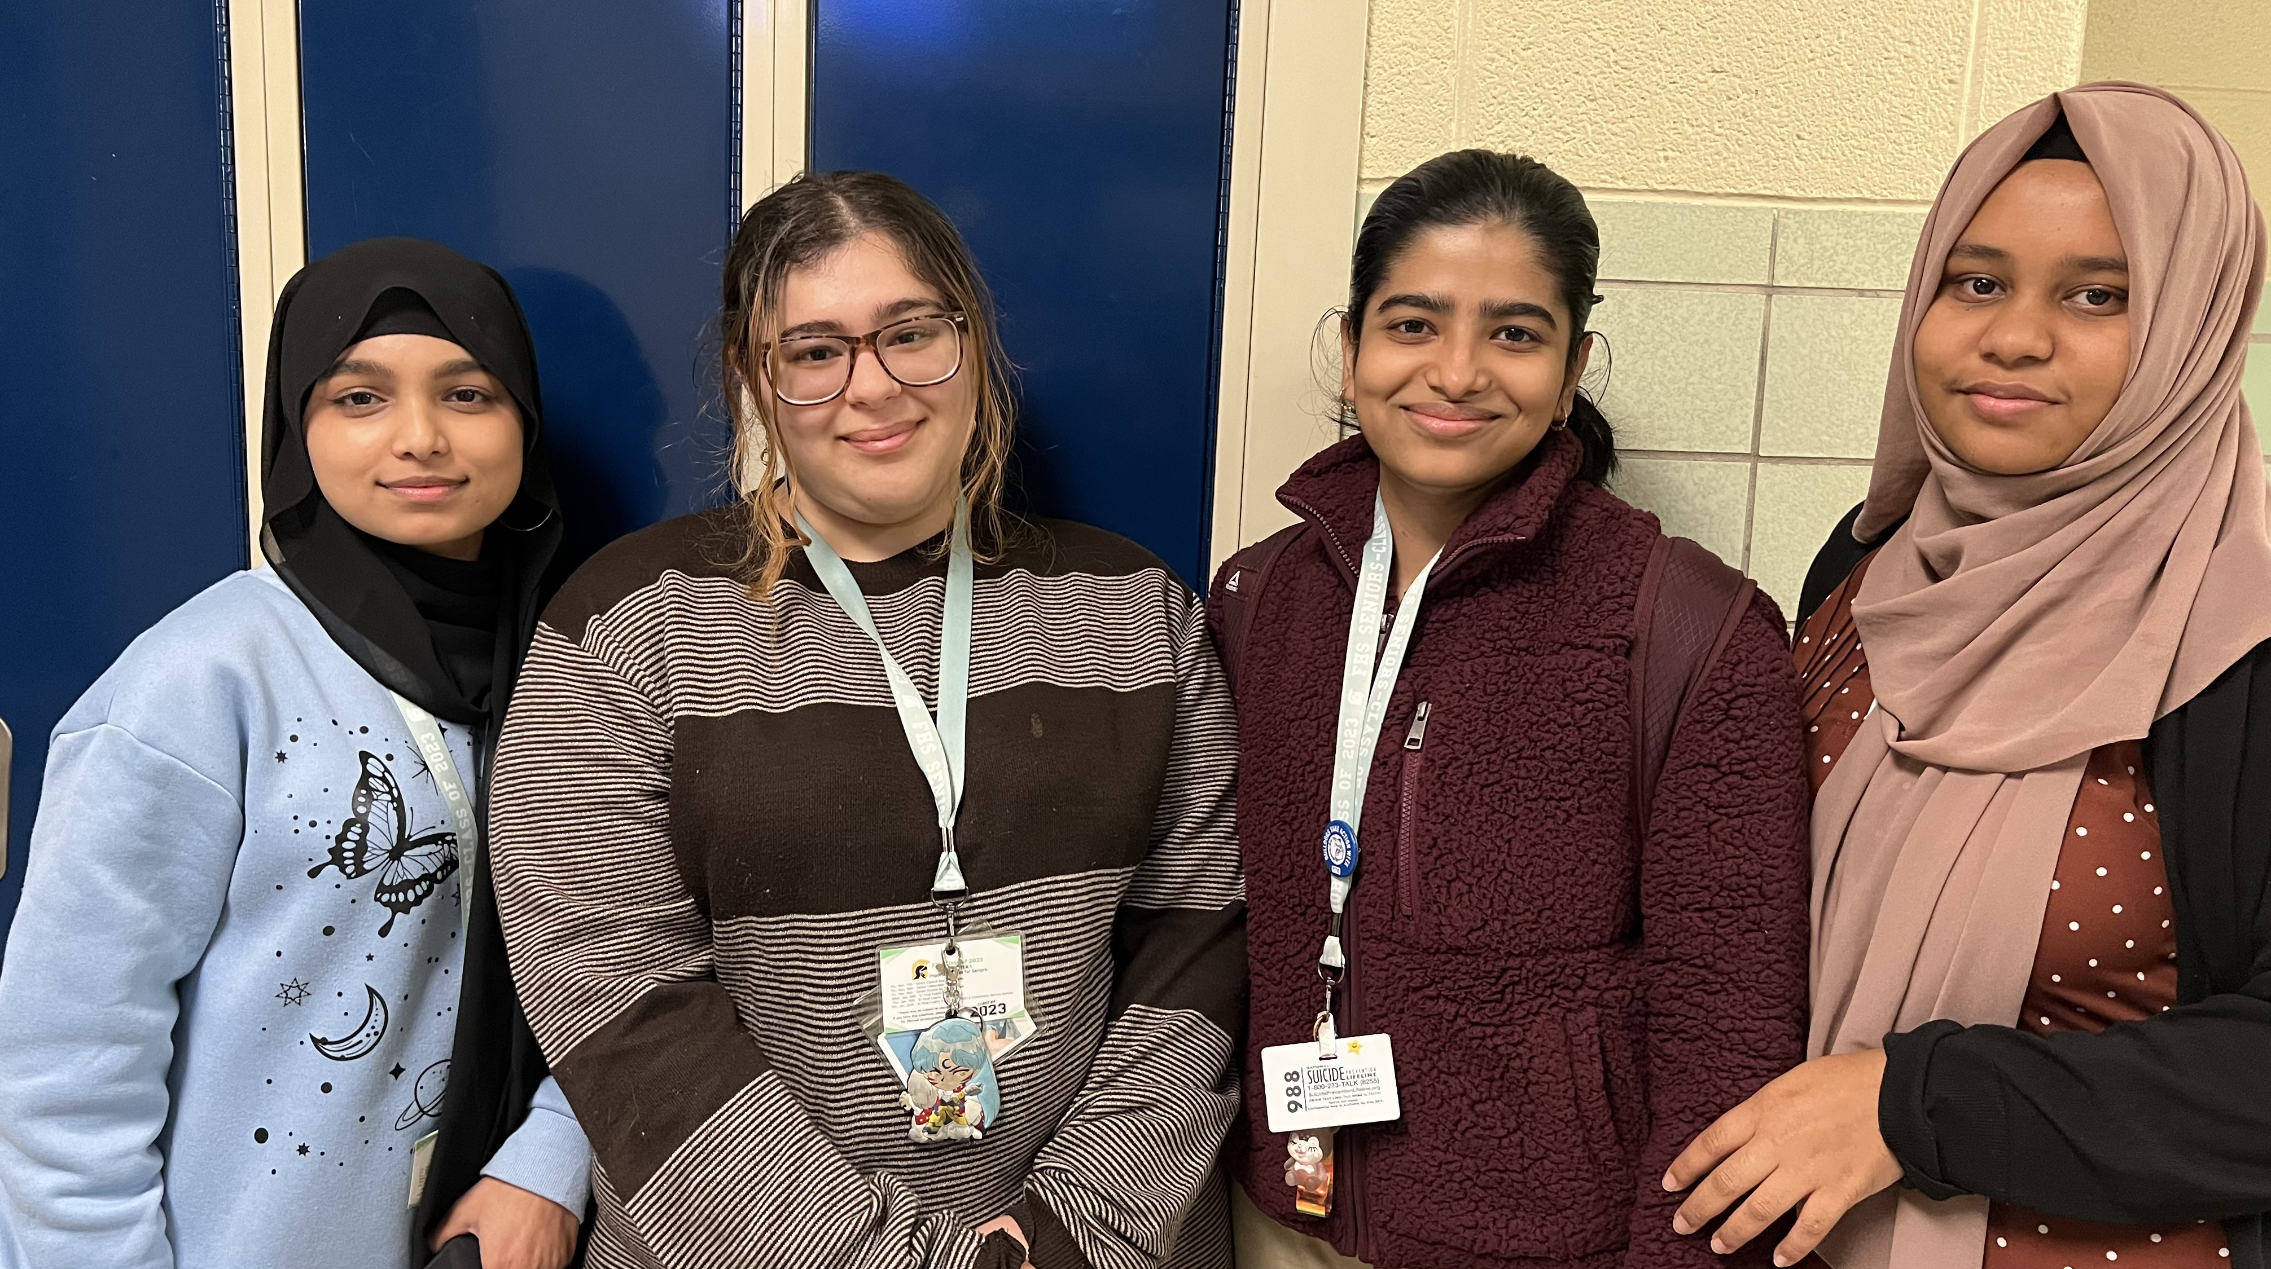
Fitzgerald High School
President: Mina Lateef
Vice President: Anisha Chowdhury
Secretary: Siddika Jannat
Treasurer: Fahmida Aktar
Social Media Chair: Bushra Khanam

Slide 8
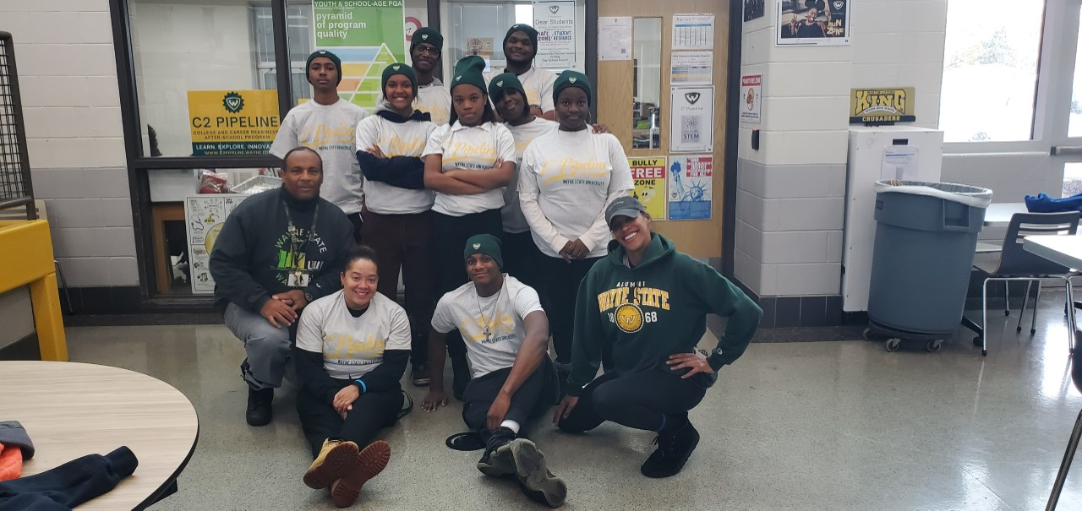
King High School
President: Joshua Fowler
Vice-President: Diamond Sewell
Secretary: Brandi Ellerbe
Treasurer: Allen Lillard
Community Engagement/Fundraising Specialist: Elijah Shabazz
Social-Media/Brand Ambassador: Julissa Walters
College/Career Explorer: Mi Joy Reed-Nash
Health Inspector: Jacqueline Garrett
Legal Fact Finder: Kalel Garrett

Slide 9
Lincoln High School
PRESIDENT: Adelyna Cruz
SECRETARY: Nyazya Graves
TREASURER: Kadyn Lewinski
SOCIAL MEDIA CHAIR: Mackenzie Jones -
Members at Large: Dennia Smith; Alyssa Sims

Slide 10
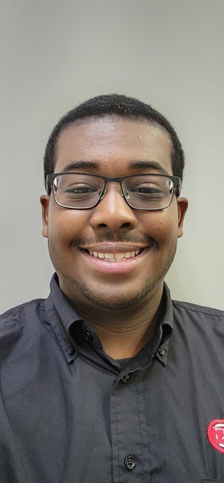
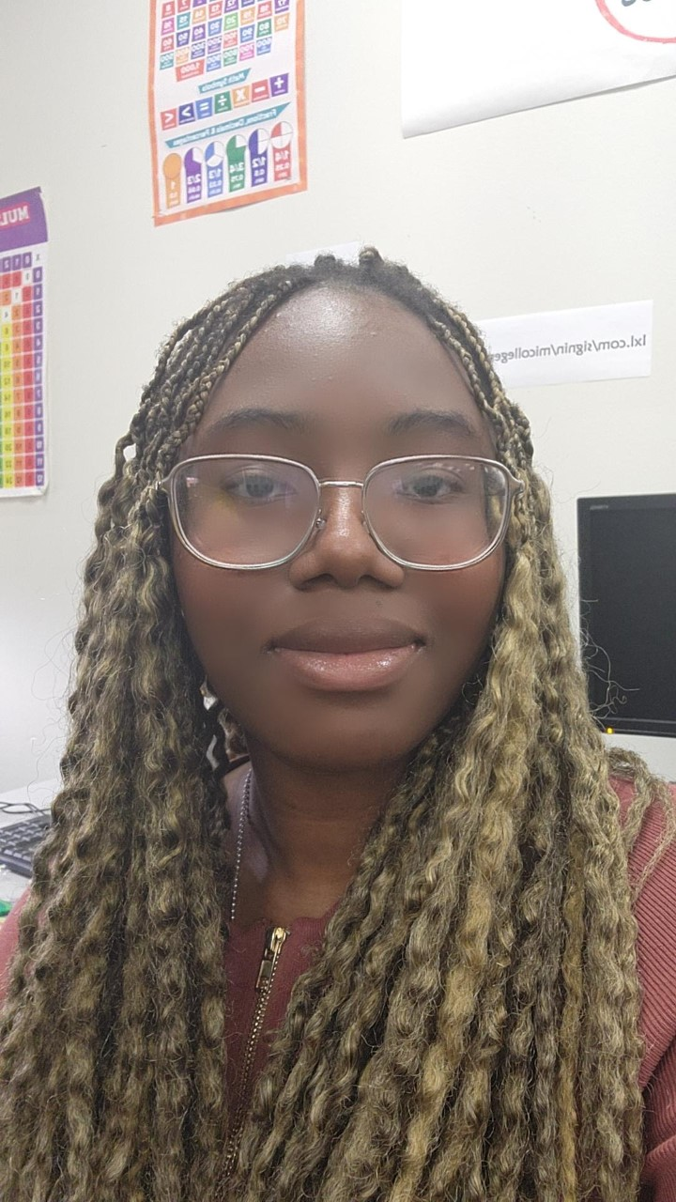
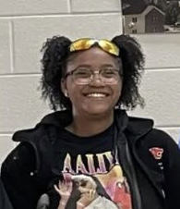
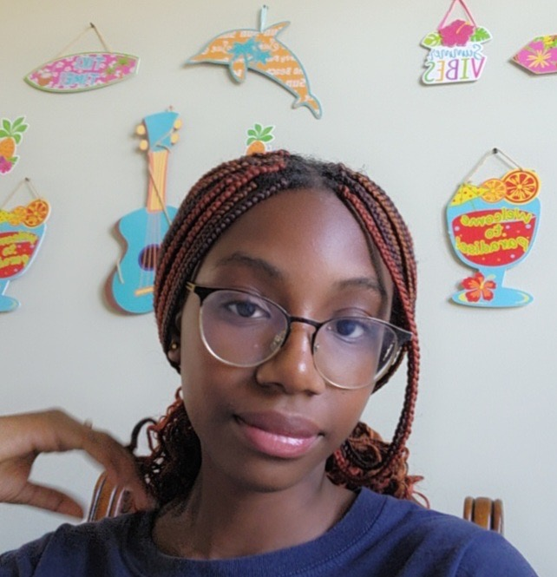
Michigan Collegiate (Conner Creek East)
President: Jonah Gaillard
Vice President: Oluchi Azugwu
Treasurer: Madison Cox
Secretary: Chinelo Azugwu
Social Media Nonye Azugwu

Slide 11
Pershing High School
President- Jeremiah Young
Vice President- James Conner
Secretary- Special Mitchell
Treasurer: Dazia Williams
Social Media Specialist: Dakayla Williams

Slide 12
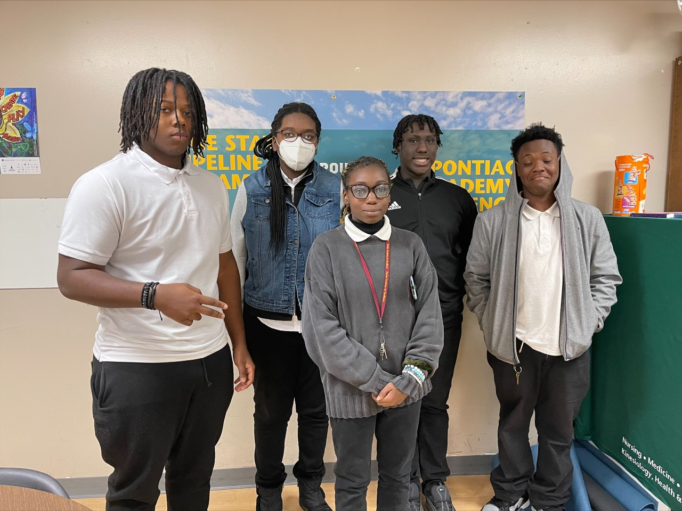
Pontiac Academy of Excellence
President: Tayshawn Lee
Vice President: Faith Hagler
Secretary: Jada Lindsey
Treasure: Arieanna White
Social Media Chair: Demarion Burrow

Slide 13
River Rouge High School
President: Rihanna Williams
Vice President: A’Zariah Ellis

Slide 14
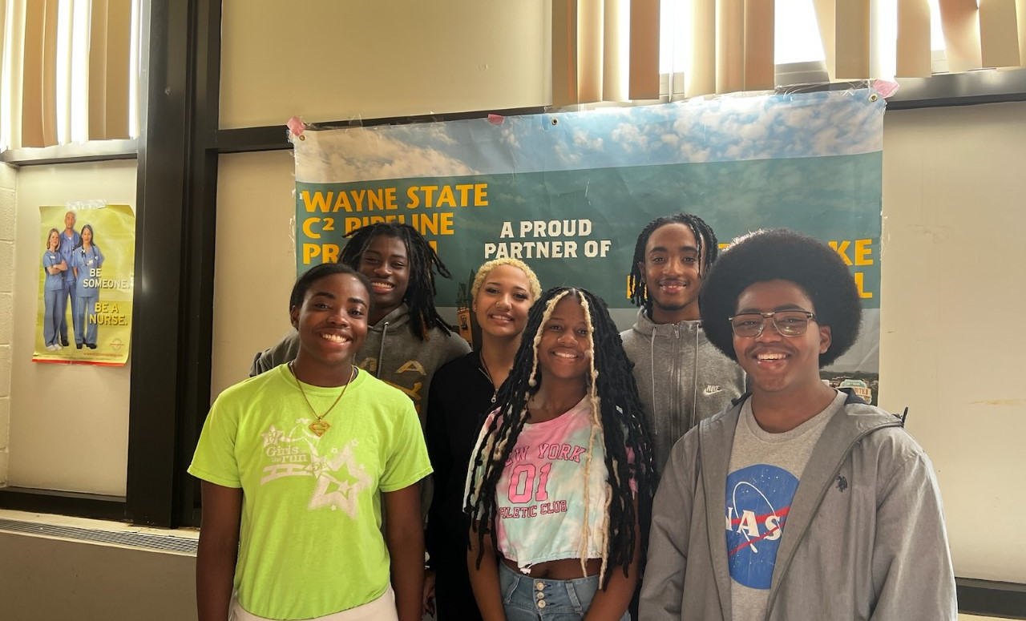
South Lake High School
President: Kendall Knox
Vice President: Nehemiah Sangster
Secretary: Aryanna Nelson
Treasurer: Trinity Sangster
Community Engagement Chair: Kyle Hugley
Social Media Chair: Jordan Keys

Slide 15
Southfield Arts & Technology
Co- President- Tamaya Fields
Co-President – Avari Terrell
Vice President- Kyla Middlebrook
Social Media- Gabe Jacobs
Social media- Lilian Payne
Treasury- Brianne Holloway

Slide 16
University High School (Ferndale)
President - Aniya Hall
Vice President - Rachel Smith
Secretary - Kassie Weje
Treasurer - Heaven Peet
Social Media Chair - Finn Nahabedian
UHS Engagement - Naveyah Knott
Community Liaison - Tiffany Holloway
Community Service - Justin Smiley
C2 Pipeline Board Members - Amiriah, Rosalyn, Danea, Cassius, Tayshawn, Dede, Laressa, Shaniya, Destiny

Slide 17
Warren Mott High School
PRESIDENT: Mariah Wells
VICE PRESIDENTS: Gabby Andrews; Isis Hanson-Franklin
SECRETARY: Leia Bowman, Samiyah Bailey
TREASURER: Caden West
SOCIAL MEDIA CHAIR: Emily Mason
Members at Large: Shekhar Sutradhar, Javari Pickett

Slide 18
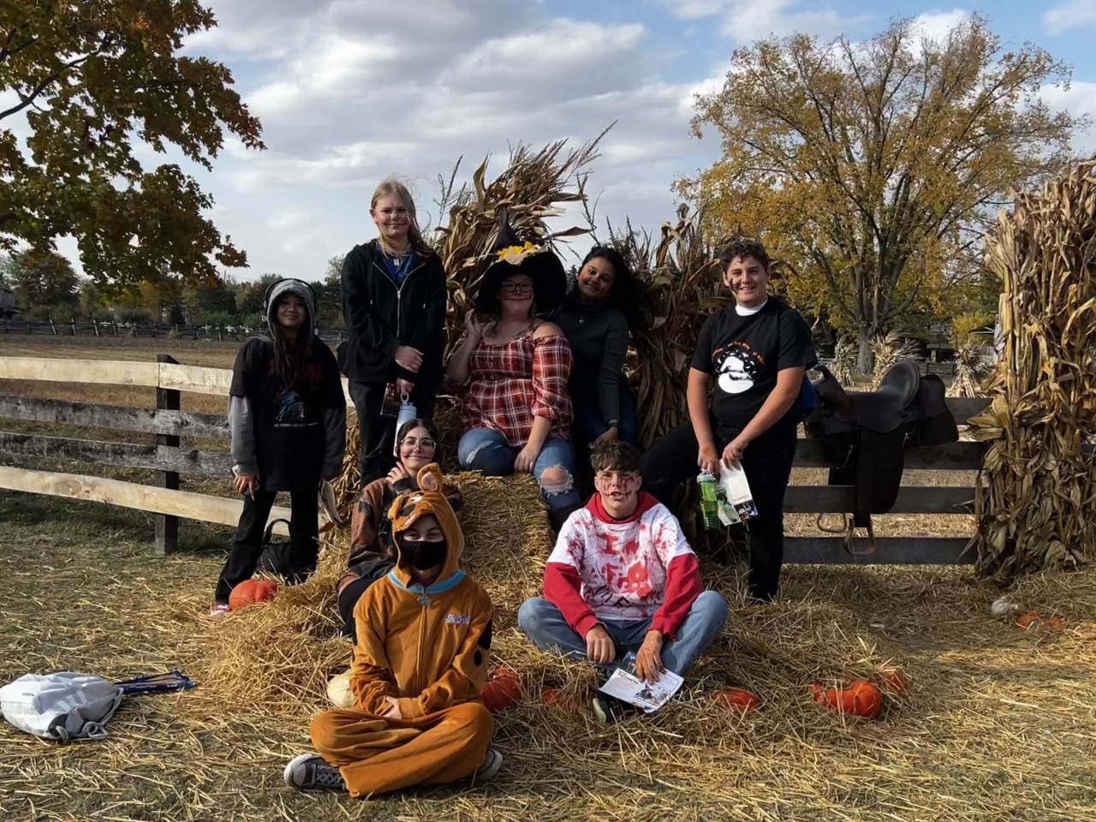
Warren Woods Towers
President: Katie Doctor
Vice President: SJ Huling
Secretary: Taliyah Dawson
Treasurer: Donna Shmouel
Social Media Chair: Gabrielle Chanthavong

Slide 19
Waterford Mott High School
President- Aliana Santana
Vice President- Elizbeth Dragonetti
Treasurer- Hailie Adcock

